Slide 1

Cyber Security
Foot printing and Reconnaissance
(Information Gathering)

Slide 2
What Is Foot printing
Foot-printing is the collection of every possible information regarding the target and target network

Slide 3
Types of Foot printing
Active
Passive

Slide 4
Information About Company
Company IP Address
Operating System on Machines
Network Basic
Employee Email Address
Web Domain Name
Important Phone Number
Identities of Key Figures in an Organization
Organization Policies
Currents or Futures Project Information
Legal Details or Documents
News Coverage or Press Releases
A Company Patents and Trademarks

Slide 5
Footprinting and Reconnaissance
Foot printing Search Engines
Foot printing Web Services
Foot printing Social Networking Sites
Whois Foot Printing
Network Foot printing
Email Foot printing
Social Engineering
Foot Printing Tools

Slide 6
Footprinting Search Engines
Google
Yahoo
Bing
Shodan.io
Duck Duck Go

Slide 7
Footprinting Web Services
- Net craft
Archive.org
Whois.com
Wappalyzer
Pentest-tools.com
OSINT Framework

Slide 8
Footprinting Social Networking Sites
Facebook
Instagram
LinkedIn
Twitter
Have i been pwned

Slide 9
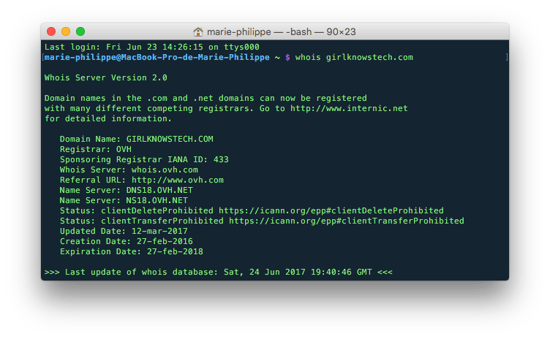
Whois Footprinting

Slide 10
Network Foot printing
Nmap - Network exploration tool and security / port scanner
Masscan - Fast scan of the Internet
Nslookup - query Internet name servers interactively
Traceroute - print the route packets trace to network host
Netdiscover - active/passive ARP reconnaissance tool

Slide 11
Email Foot printing
Email is one of the most popular, widely used professional ways of communication which is used by every organization.
Tracing an email using email header can reveal the following:-
Destination address
Sender IP Address
Sender Mail Address
Time & Date information
Authentication system information of sender’s mail server

Slide 12
Social Engineering
Social engineering is a manipulation technique that exploits human error to gain private information access.

Slide 13
Foot Printing Tools
Whois
The Harvester
Maltego
Spider Foot
Metagoofil
Dmitry
NsLookup .etc

Slide 14
Thank You

